Slide 1
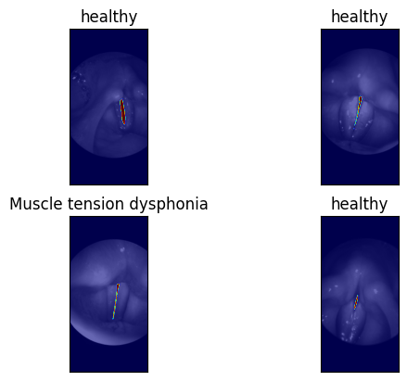
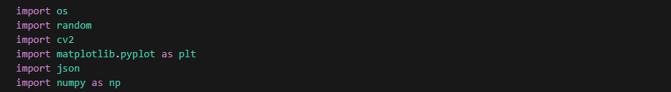
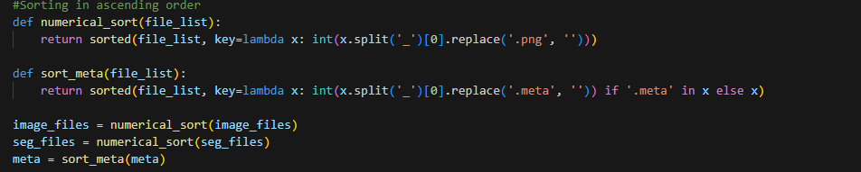

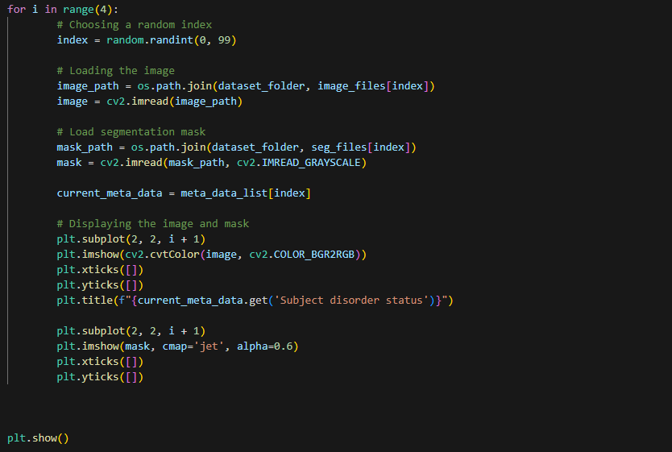
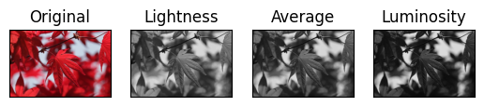
Task 1
Task 2
Task 3
Task 4
From a computing point of view, I think the lightness method is preferred owing to the lesser number of floating point arithmetic operations being used when compared to the other two methods. This would hence, ultimately lead to lesser round off errors. The other two methods depend on the resolution of an image (since the weighted average for luminosity and average method take into account number of pixels ) and more round off errors could arise.
Alap Mundayoor, M.N. 23351429, IdM: ow07ysym

